Slide 1
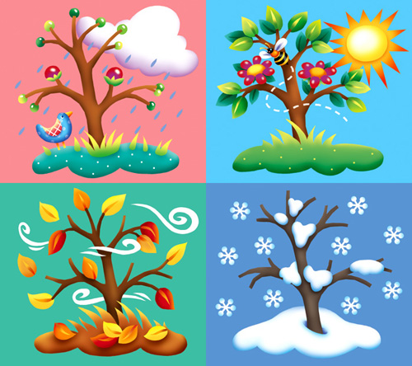
Seasons
Let’s
play!
Start

Slide 2
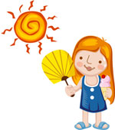
It’s the warmest time of the year.
Next

Slide 3
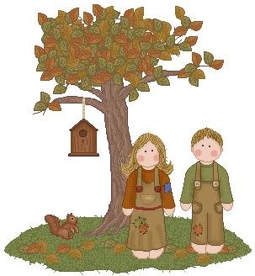
The leaves on some trees change colors. Some trees lose their leaves.
Next

Slide 4
Leaves sprout on the trees, seeds begin to grow and flowers begin to bloom.
Next

Slide 5
It is the coldest time of the year.
Next

Slide 6
It’s time to gather acorns and nuts.
Next

Slide 7
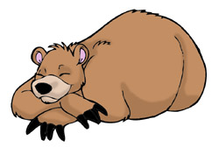
Some animals sleep during this time of year.
Next

Slide 8
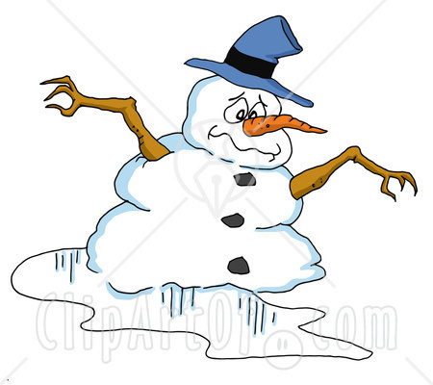
The land gets warmer and ice melts.
Next

Slide 9
It’s cold and snow falls.
Next

Slide 10
It is rainy a lot this time of the year.
Next

Slide 11
The sun is shining and people are sunbathing at the beach.
Next

Slide 12
We celebrate Christmas this season.
Next

Slide 13
We celebrate Easter this season.
Next

Slide 14
Butterflies, bees and other bugs come out.
The end

