Slide 1
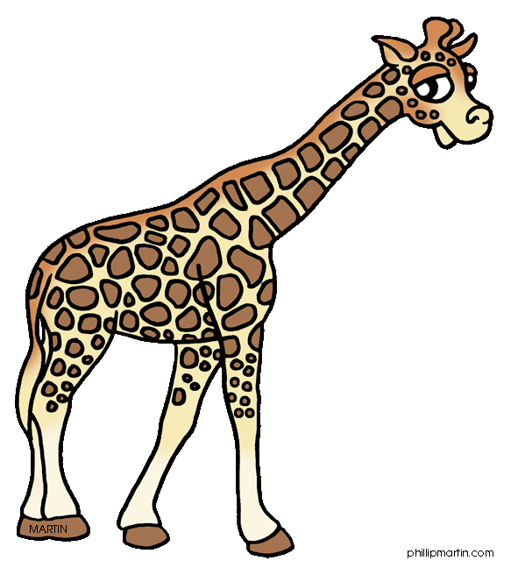
Where
How many
When
What
Who
Text or image
Game

Slide 2
Where
How many
When
What
Who
Text or image
………….. is that?
It’s a giraffe.

Slide 3
Where
How many
When
What
Who
Text or image
………….. is the giraffe?
It’s in front of a tree.

Slide 4
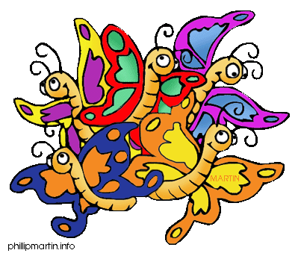
Where
How many
When
What
Who
Text or image
….……... butterflies are there?
There are five butterflies.

Slide 5
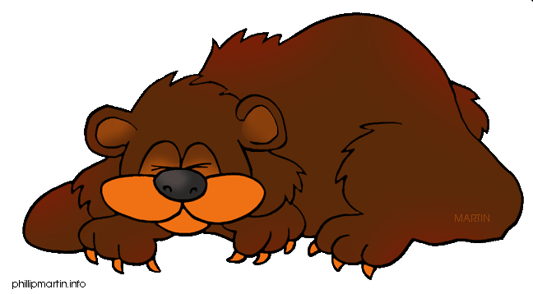
Where
How many
When
What
Who
Text or image
………….. is sleeping?
The bear is sleeping.

Slide 6
Where
How many
When
What
Who
Text or image
………….. do you sleep?
I sleep in winter.

Slide 7
Where
How many
When
What
Who
Text or image
………….. is the eagle doing?
It is flying.

Slide 8
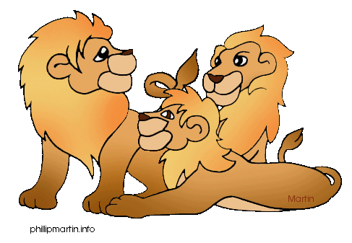
Where
How many
When
What
Who
Text or image
………….. lions are there ?
There are three lions.

Slide 9
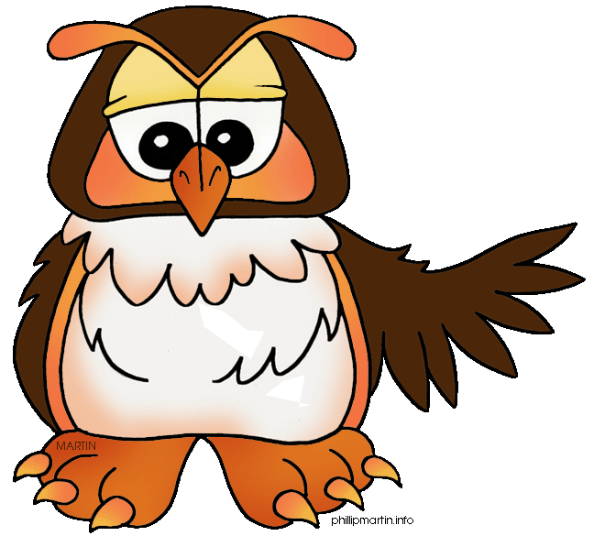
Where
How many
When
What
Who
Text or image
………….. do you sleep?
I sleep during the day.

Slide 10
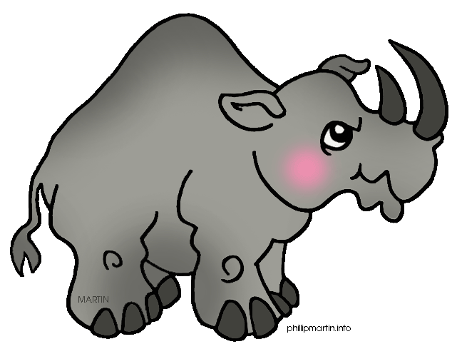
Where
How many
When
What
Who
Text or image
………….. is the rhino ?
It’ s next to the lake.

Slide 11
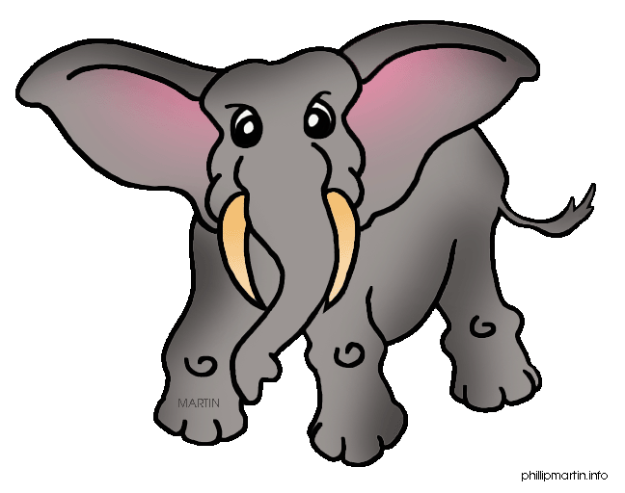
Where
How many
When
What
Who
Text or image
………….. is coming?
The elephant is coming.

