Slide 1
Numbers 1-20
GAME
S
T
A
R
T
a
b
c
d
e
f
g
h
i
j
k
l
m
n
o
p
q
r
s
t
u
v
w
x
y
z
NEXT

Slide 2
Count:
t
w
o
a
b
c
d
e
f
g
h
i
j
k
l
m
n
o
p
q
r
s
t
u
v
w
x
y
z
NEXT

Slide 3
Count:
t
e
n
a
b
c
d
e
f
g
h
i
j
k
l
m
n
o
p
q
r
s
t
u
v
w
x
y
z
NEXT

Slide 4
Count:
t
w
e
n
t
y
a
b
c
d
e
f
g
h
i
j
k
l
m
n
o
p
q
r
s
t
u
v
w
x
y
z
NEXT

Slide 5
Count:
n
i
n
e
a
b
c
d
e
f
g
h
i
j
k
l
m
n
o
p
q
r
s
t
u
v
w
x
y
z
NEXT

Slide 6
Count:
s
i
x
a
b
c
d
e
f
g
h
i
j
k
l
m
n
o
p
q
r
s
t
u
v
w
x
y
z
NEXT

Slide 7
Count:
o
n
e
a
b
c
d
e
f
g
h
i
j
k
l
m
n
o
p
q
r
s
t
u
v
w
x
y
z
NEXT

Slide 8
Count:
f
i
f
t
e
e
n
a
b
c
d
e
f
g
h
i
j
k
l
m
n
o
p
q
r
s
t
u
v
w
x
y
z
NEXT

Slide 9
Count:
t
h
r
e
e
a
b
c
d
e
f
g
h
i
j
k
l
m
n
o
p
q
r
s
t
u
v
w
x
y
z
NEXT

Slide 10
Count:
e
i
g
h
t
e
e
n
a
b
c
d
e
f
g
h
i
j
k
l
m
n
o
p
q
r
s
t
u
v
w
x
y
z
NEXT

Slide 11
Count:
s
e
v
e
n
a
b
c
d
e
f
g
h
i
j
k
l
m
n
o
p
q
r
s
t
u
v
w
x
y
z
NEXT

Slide 12
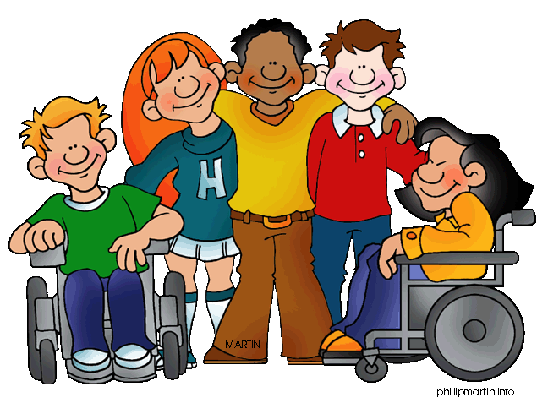
Count:
f
i
v
e
a
b
c
d
e
f
g
h
i
j
k
l
m
n
o
p
q
r
s
t
u
v
w
x
y
z
NEXT

Slide 13
Count:
e
i
g
h
t
a
b
c
d
e
f
g
h
i
j
k
l
m
n
o
p
q
r
s
t
u
v
w
x
y
z
NEXT

Slide 14
Count:
s
i
x
t
e
e
n
a
b
c
d
e
f
g
h
i
j
k
l
m
n
o
p
q
r
s
t
u
v
w
x
y
z
NEXT

Slide 15
Count:
s
e
v
e
n
t
e
e
n
a
b
c
d
e
f
g
h
i
j
k
l
m
n
o
p
q
r
s
t
u
v
w
x
y
z
NEXT

Slide 16
Count:
f
o
u
r
a
b
c
d
e
f
g
h
i
j
k
l
m
n
o
p
q
r
s
t
u
v
w
x
y
z
NEXT

Slide 17
Count:
t
h
i
r
t
e
e
n
a
b
c
d
e
f
g
h
i
j
k
l
m
n
o
p
q
r
s
t
u
v
w
x
y
z
NEXT

Slide 18
Count:
t
w
e
l
v
e
a
b
c
d
e
f
g
h
i
j
k
l
m
n
o
p
q
r
s
t
u
v
w
x
y
z
NEXT

Slide 19
Count:
f
o
u
r
t
e
e
n
a
b
c
d
e
f
g
h
i
j
k
l
m
n
o
p
q
r
s
t
u
v
w
x
y
z
NEXT

Slide 20
Count:
n
i
n
e
t
e
e
n
a
b
c
d
e
f
g
h
i
j
k
l
m
n
o
p
q
r
s
t
u
v
w
x
y
z
NEXT

Slide 21
Count:
e
l
e
v
e
n
a
b
c
d
e
f
g
h
i
j
k
l
m
n
o
p
q
r
s
t
u
v
w
x
y
z
END

