Slide 1
How are you feeling?
happy
sad
confused
sleepy
Game
frightened
bored
Start
grumpy
Love struck
surprised

Slide 2
How are you feeling?
happy
sad
confused
sleepy
frightened
bored
grumpy
Love struck
surprised

Slide 3
How are you feeling?
happy
sad
confused
sleepy
frightened
bored
grumpy
Love struck
surprised

Slide 4
How are you feeling?
happy
sad
confused
sleepy
frightened
bored
grumpy
Love struck
surprised

Slide 5
How are you feeling?
happy
sad
confused
sleepy
frightened
bored
grumpy
Love struck
surprised

Slide 6
How are you feeling?
happy
sad
confused
sleepy
frightened
bored
grumpy
Love struck
surprised

Slide 7
How are you feeling?
happy
sad
confused
sleepy
frightened
bored
grumpy
Love struck
surprised

Slide 8
How are you feeling?
happy
sad
confused
sleepy
frightened
bored
grumpy
Love struck
surprised

Slide 9
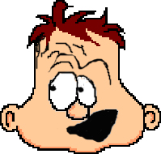
How are you feeling?
happy
sad
?
confused
sleepy
frightened
bored
grumpy
Love struck
surprised

Slide 10
How are you feeling?
happy
sad
confused
sleepy
frightened
bored
grumpy
Love struck
surprised

